Slide 1
January 31, 2022
eGRC Vendor Risk
Owner
Ryan Nishimoto, Tech Financial Ops Team, The Data Squad, Louis A. Boney

Slide 2

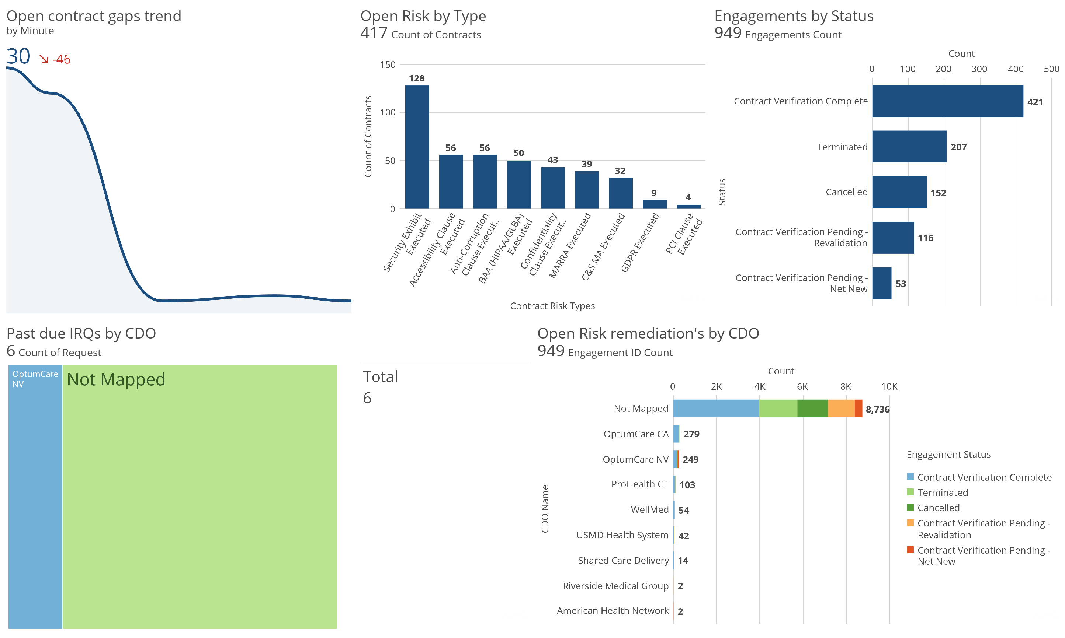

Slide 3
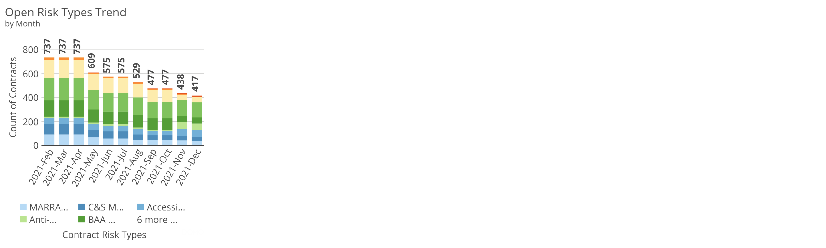
Appendix

